Slide 1


Ensemble Methods

Slide 2
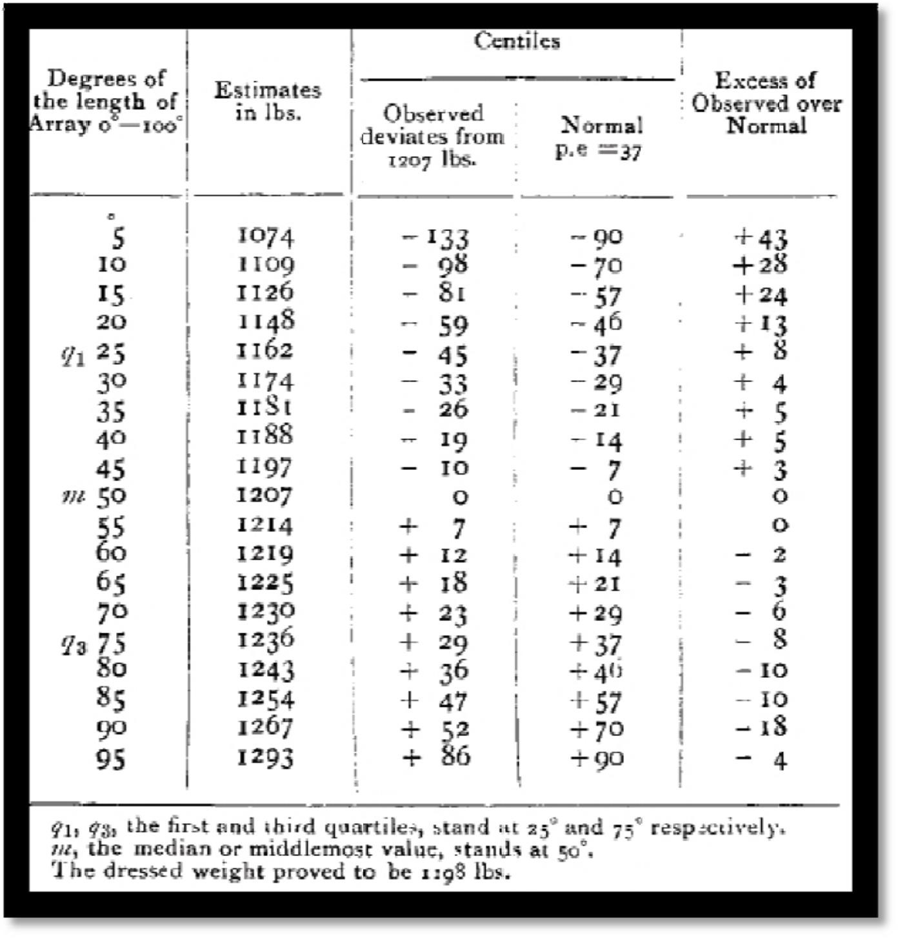
THE GENERAL IDEA
E N S E M B L E M E T H O D S

Slide 3



THE GENERAL IDEA
E N S E M B L E M E T H O D S
Original Training data
D
Step 1: Create Multiple
Data Sets
....
D₁
D₂
^{D}t-1
D_{t}
Step 2: Build Multiple
Classifiers
C
C
C
C
1
2
t -1
t
Step 3: Combine Classifiers
_{C}*

Slide 4

RANDOM FOREST
E N S E M B L E M E T H O D S
class
Tid | Refund | Marital Status | Taxable Income | Fraud
1 | Yes | Single | 125K | NO
2 | No | Married | 100K | NO
3 | No | Single | 70K | NO
4 | Yes | Married | 120K | NO
5 | No | Divorced | 95K | YES
6 | No | Married | 60K | NO
7 | Yes | Divorced | 220K | NO
8 | No | Single | 85K | YES
9 | No | Married | 75K | NO
10 | No | Single | 90K | YES
10
Training Data Matrix

Slide 5
RANDOM FOREST DATA MATRICES
E N S E M B L E M E T H O D S
Tid | Marital Status | Taxable Income | Fraud
1 | Single | 125K | NO
2 | Married | 100K | NO
3 | Single | 70K | NO
4 | Married | 120K | NO
5 | Divorced | 95K | YES
6 | Married | 60K | NO
7 | Divorced | 220K | NO
8 | Single | 85K | YES
9 | Married | 75K | NO
10 | Single | 90K | YES
Tid | Refund | Taxable Income | Fraud
1 | Yes | 125K | NO
2 | No | 100K | NO
3 | No | 70K | NO
4 | Yes | 120K | NO
5 | No | 95K | YES
6 | No | 60K | NO
7 | Yes | 220K | NO
8 | No | 85K | YES
9 | No | 75K | NO
10 | No | 90K | YES
Tid | Refund | Marital Status | Fraud
1 | Yes | Single | NO
2 | No | Married | NO
3 | No | Single | NO
4 | Yes | Married | NO
5 | No | Divorced | YES
6 | No | Married | NO
7 | Yes | Divorced | NO
8 | No | Single | YES
9 | No | Married | NO
10 | No | Single | YES
10
10
10
Matrix 1 Matrix 3
Matrix 2
Feature Subset Training Data Matrices

Slide 6
RANDOM FOREST TREE MODELS
E N S E M B L E M E T H O D S
MarSt
Refund
MarSt
Married
Yes
No
Married
Single, Divorced
Single, Divorced
NO
TaxInc
TaxInc
NO
Refund
NO
< 80K
>= 80K
YES
>= 80K YES
Yes
< 80K
No
YES
NO
NO
NO
Model 1
Model 2
Model 3

Slide 7
RANDOM FOREST APP LY MODEL
E N S E M B L E M E T H O D S
Refund | Marital Status | Taxable Income | Fraud
No | Married | 80K | ?
10
MarSt
Refund
MarSt
Married
Yes
No
Married
Single, Divorced
Single, Divorced
NO
TaxInc
TaxInc
NO
Refund
NO
< 80K
>= 80K
YES
>= 80K
YES
Yes
< 80K
No
YES
NO
NO
NO
Model 1
Model 2
Model 3
NO
YES
NO

Slide 8
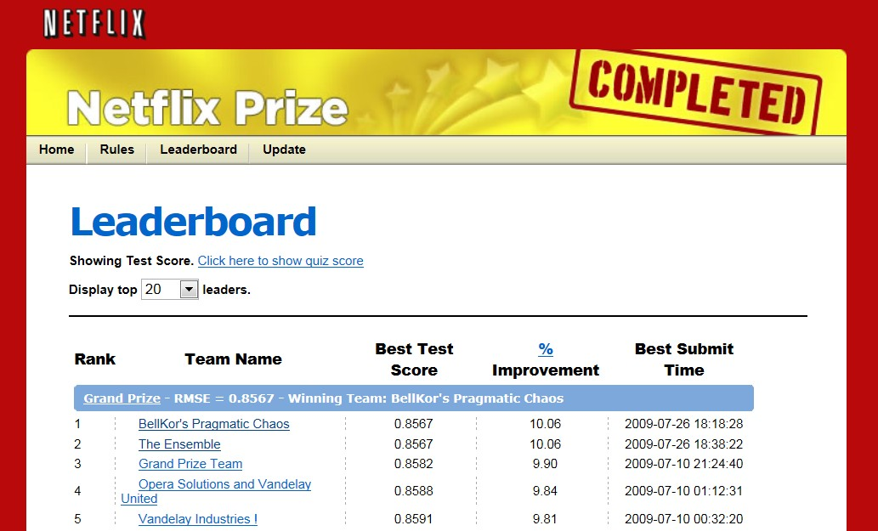
THE NETFLIX COMPETITION
E N S E M B L E M E T H O D S

